Slide 1
BOOLEAN FUNCTIONS
Ex 1 f2
Cireap Bogdan gr 912

Slide 2
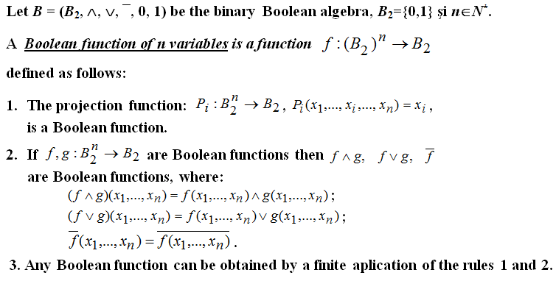
Boolean functions

Slide 3
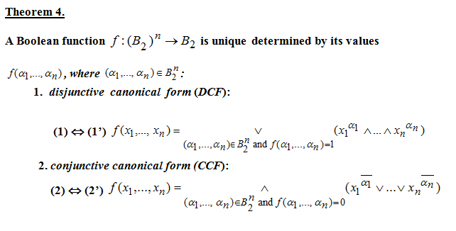
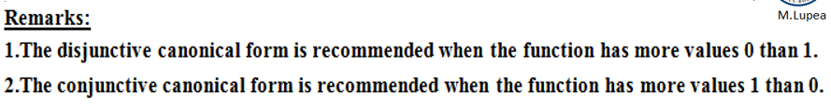

Slide 4
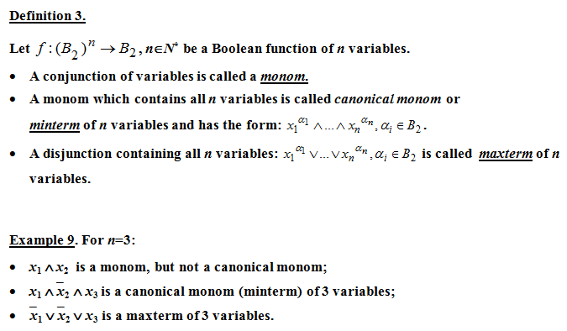
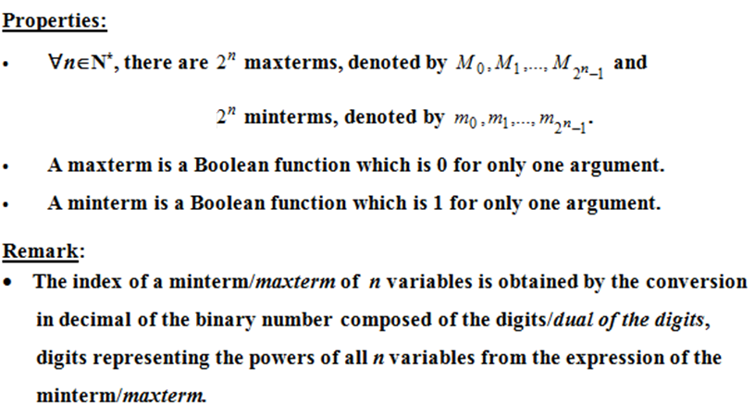

Slide 5
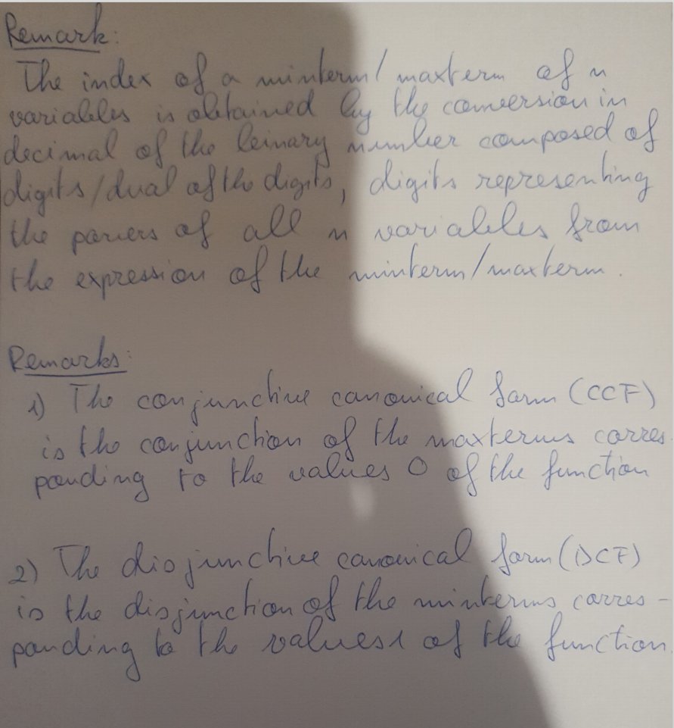
Scanned remarks

Slide 6
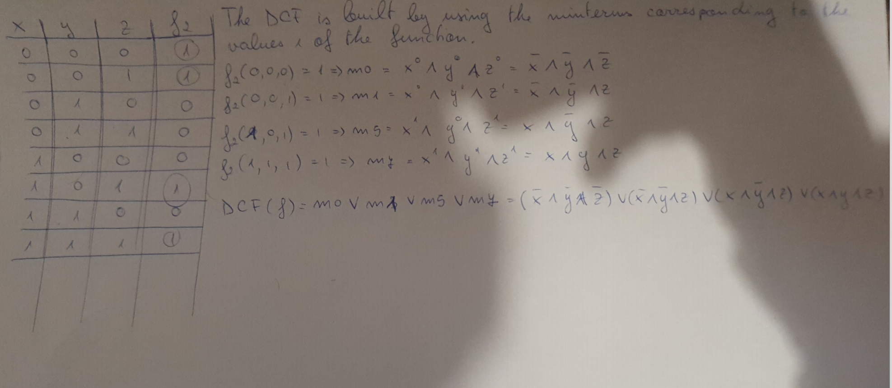
Scanned dcf

Slide 7
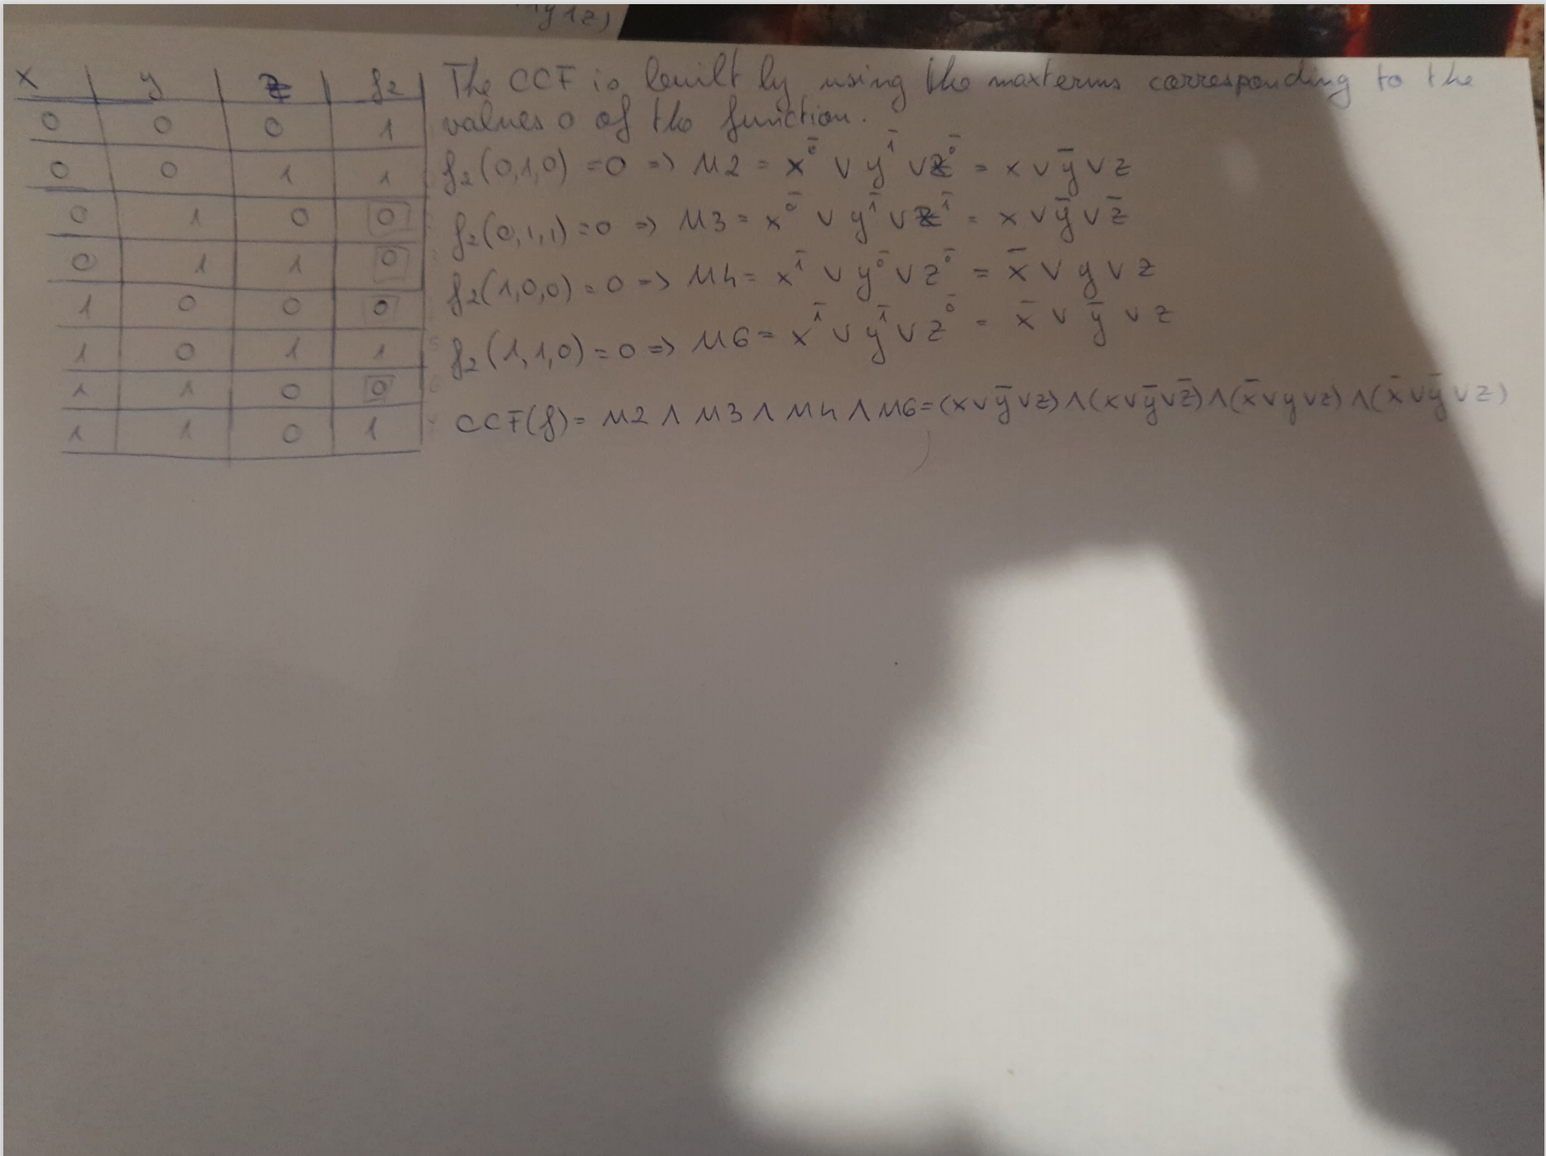
Scanned ccf

Slide 8
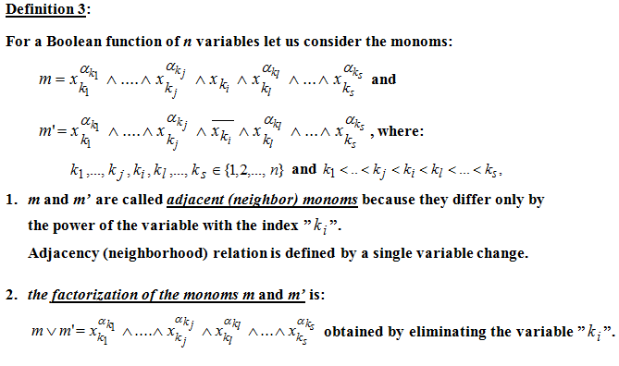
Boolean function simplification

Slide 9
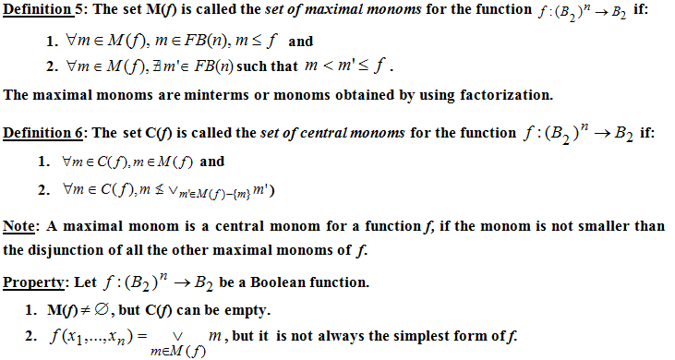

Slide 10
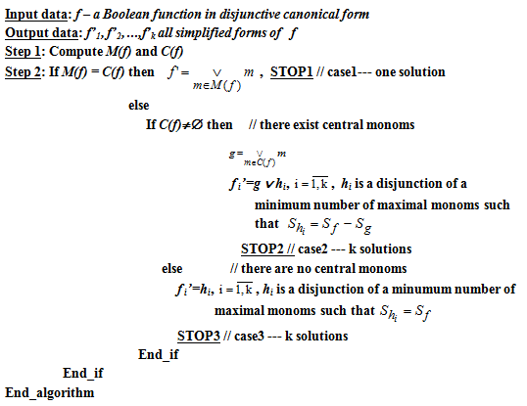
Simplification of DCF

Slide 11
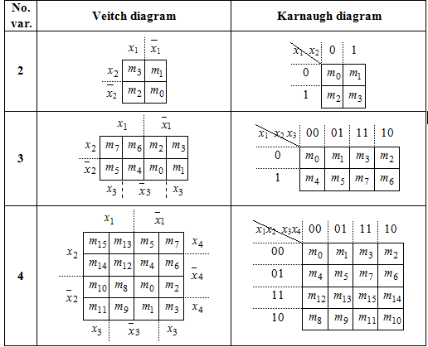
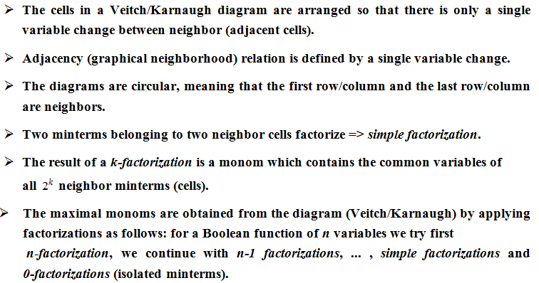
Veitch-Karnaugh Diagrams Method

Slide 12
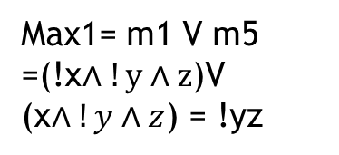
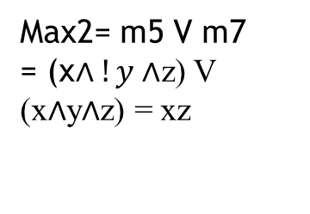
Using Karnaugh diagrams simplify both DCF and CCF
DCF(f) = m0 V m1 V m5 V m7 = (($\overline{x}∧\overline{y}∧\overline{z}$ ) $∨$ ($\overline{x}∧\overline{y}∧z$ ) $∨$ $(x∧\overline{y}∧z$ ) $∨$ ($x∧y∧z$ )
Factorization process => the set of maximal monoms M(f)
yz | 00 | 01 | 11 | 10
0 |  | m1
0 |  | m5
yz | 00 | 01 | 11 | 10
0 | m0 | m1
1 |  | m5 | m7
x
x
Max1= m1 V m5
=(!x$∧!y∧z$)V
(x$∧!y∧z$) = !yz
2 groups of 2 neighbor minterms
One isolated minterm
Max3=m0 V m1 = !x!y
M(f)= {max1,max2,max3}: maximal monoms
yz | 00 | 01 | 11 | 10
0
1 |  | m5 | m7
Max2= m5 V m7
= (x$∧!y∧$z) V (x$∧$y$∧$z) = xz
x

Slide 13
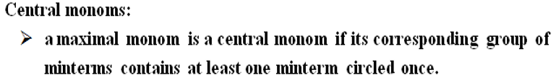
max1=!yz
max2=xz
max3=!x!y
C(f)= {max2,max3} =
The minterms covered my the central monoms are circled
M(f) != C(f) ! = empty set => second case of simplification algorithm
G= max2 V max3
There is only one simplified form because G covers all the minterms:
F2(x,y,z) = max2Vmax3 =G(x,y,z) = xz V !x!y
yz | 00 | 01 | 11 | 10
0 | m0 | m1
1 |  | m5 | m7
x

Slide 14
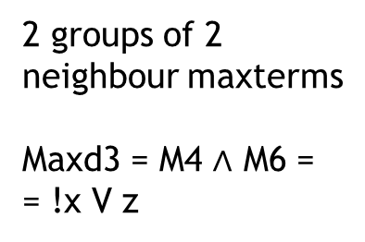
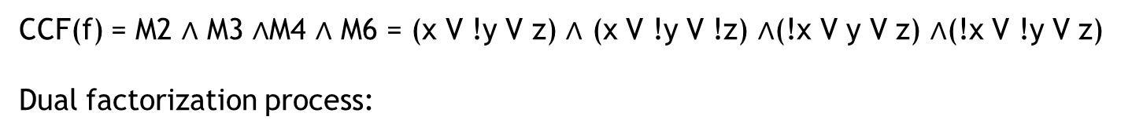
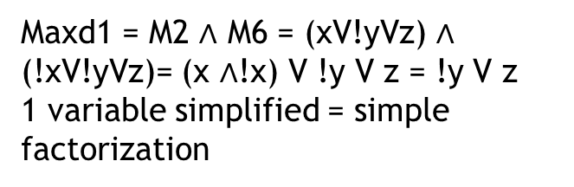
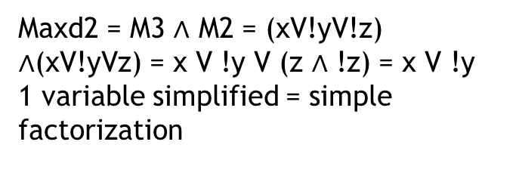
CCF(f) = M2 $∧$ M3 $∧$M4 $∧$ M6 = (x V !y V z) $∧$ (x V !y V !z) $∧$(!x V y V z) $∧$(!x V !y V z)
Dual factorization process:
yz | 00 | 01 | 11 | 10
0 |  |  | M3 | M2
1 | M4 |  |  | M6
x
2 groups of 2 neighbour maxterms
Maxd3 = M4 $∧$ M6 =
= !x V z
yz | 00 | 01 | 11 | 10
0 |  |  | M3 | M2
1 | M4 |  |  | M6
yz | 00 | 01 | 11 | 10
0 |  |  | M3 | M2
1 | M4
x
x
Maxd1 = M2 $∧$ M6 = (xV!yVz) $∧$ (!xV!yVz)= (x $∧$!x) V !y V z = !y V z
1 variable simplified = simple factorization
Maxd2 = M3 $∧$ M2 = (xV!yV!z) $∧$(xV!yVz) = x V !y V (z $∧$ !z) = x V !y
1 variable simplified = simple factorization

Slide 15
Cd(f) = {maxd2,maxd3} = set of central monoms
G = maxd2 V maxd3
There is only one simplified form because G covers all the maxterms:
F2(x,y,z) = maxd2Vmaxd3 =G(x,y,z) =(x V !y) V ( !x V z)
We compare the disjunctive and conjunctive simplified forms
f2ds(x,y,z)=xz V !x!y
Has 2 unary operations 4 occurences of variables and 3 binary operations
f2cs(x,y,z)=(x V !y) V ( !x V z) =
Has 2 unary operations 4 occurences of variables and 4 binary operations
=> f2cs(x,y,z)=(x V !y) V ( !x V z) is the simplest equivalent form of f

